Slide 1
Advanced Openacc Course
Lecture 1: Advanced Profiling, May 19, 2016

Slide 2
Course Objective: Enable you to scale your applications on multiple GPUs and optimize with profiler tools

Slide 3
May 19: Advanced Profiling of OpenACC Code
May 26: Office Hours
June 2: Advanced multi-GPU Programming with MPI and OpenACC
June 9: Office Hours
Course Syllabus
Recordings:
https://developer.nvidia.com/openacc-advanced-course

Slide 4
Advanced Profiling of Openacc Code
Lecture 1: Ty McKercher, NVIDIA

Slide 5
3 Ways to Accelerate Applications
Applications
Libraries
OpenACC Directives
Programming Languages
“Drop-in” Acceleration
Easily Accelerate Applications
Maximum Flexibility
Notes:
There are 3 basic approaches to adding GPU acceleration to your applications.
But first, many applications are already GPU-accelerated. So find out if the
application you are interested in already uses GPUs.
If you are developing your own application, you can add GPU acceleration by:
1. Dropping in pre-optimized GPU-accelerated libraries as an alternative to MKL, IPP, FFTW and other widely used libraries
2. Adding some directives (or compiler “hints”) in your source code to automatically parallelize loops
3. Using the programming languages you already know to implement your own parallel algorithms
For each performance-critical area in your application, these approaches can be used independently or together.
For example you can use a GPU-accelerated library to perform some initial calculations on your data and then write your own code to perform custom calculations not (yet) available in a library.
The CUDA parallel computing platform and programming model supports all of these approaches.
So, let’s take a closer look at each approach.

Slide 6

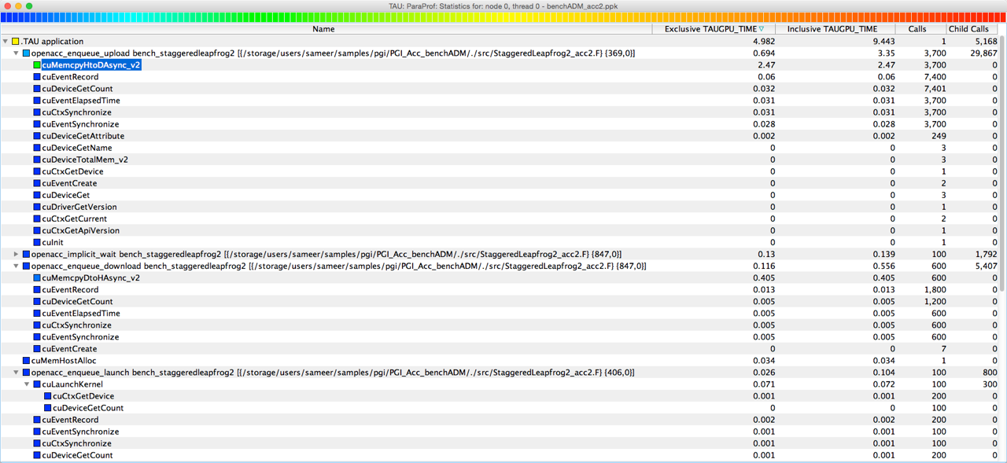
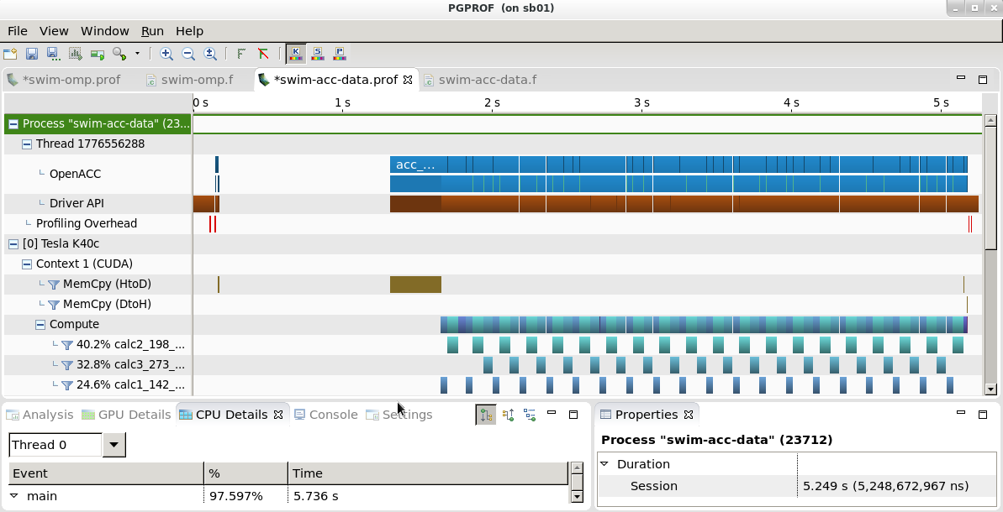
OpenACC Profiling Tools
Tools Interface
TAU
Vampir
“
The OpenACC profiling interface lets us easily measure and investigate implicit operations introduced by the compiler or runtime. Implementation was straightforward and basically worked out of the box.
”
Score-P
PGPROF
Dipl.-Ing. Robert Dietrich, T-U Dresden

Slide 7
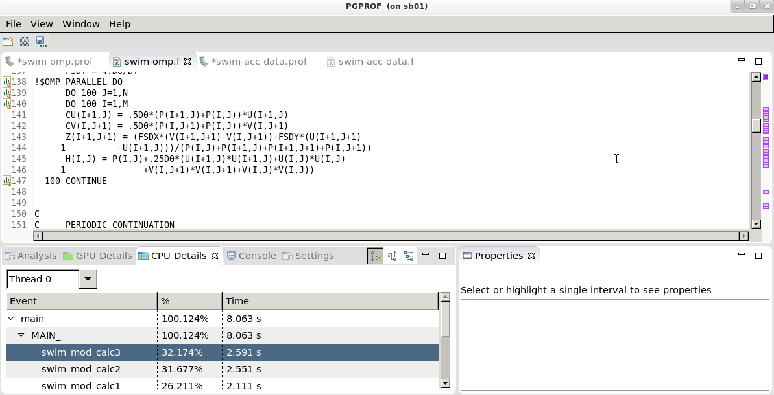
PGPROF: OpenACC CPU and GPU profiler
Available with the latest OpenACC Toolkit
For 64-bit multicore processor-based systems with or without accelerators
Supports thread-level OpenMP profiling
Supports profiling OpenACC and CUDA Fortran codes on NVIDIA CUDA-enabled GPU accelerators
Graphical and command-line user interfaces
Function level (routine) and source code line level profiling
Comprehensive built-in help facilities
http://www.pgroup.com/products/pgprof.htm

Slide 10
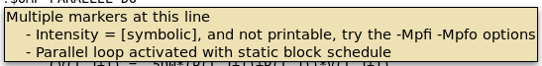

Slide 11
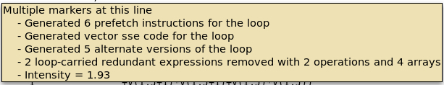

Slide 13
More on Visual Profiler
Office Hour on May 26th
PGPROF Quick Start Guide: http://www.pgroup.com/resources/pgprof-quickstart.htm
PGPROF User’s Guide*: http://www.pgroup.com/doc/pgprofug.pdf
* Updated version by May 25th

Slide 14
Profiling application - Getting Started
Acceleration with Managed Memory
Optimization with Data Directives
Multicore comparison
Seismic Unix Configuration
Agenda

Slide 15
Profiling Application – Getting Started

Slide 16
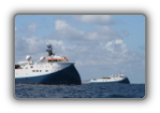
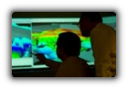
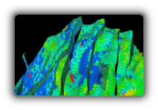
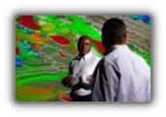
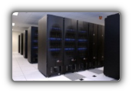

Exploration & Production Workflow
Acquire Seismic Data
Process Seismic Data
Interpret Seismic Data
Characterize Reservoirs
Drill Wells
Simulate Reservoirs
Images courtesy Schlumberger

Slide 17

Exploration & Production Workflow
Process Seismic Data
Interpret Seismic Data
Characterize Reservoirs
Drill Wells
Simulate Reservoirs
Acquire Seismic Data
Images courtesy Schlumberger

Slide 18
Acquire Seismic Data
SHOT 1
Source
Receivers
Offset (Distance)
Direct Arrival
R1
R2
R3
R4
R5
S1
R1
R2
R3
R4
R5
Direct Arrival
1
2
TWT
Reflections
3
Reflection
For each shot, reflections are recorded in 5 receivers
There are 5 ‘bounce’ points along interface 3
Images courtesy: Schlumberger, GTC 2015

Slide 19
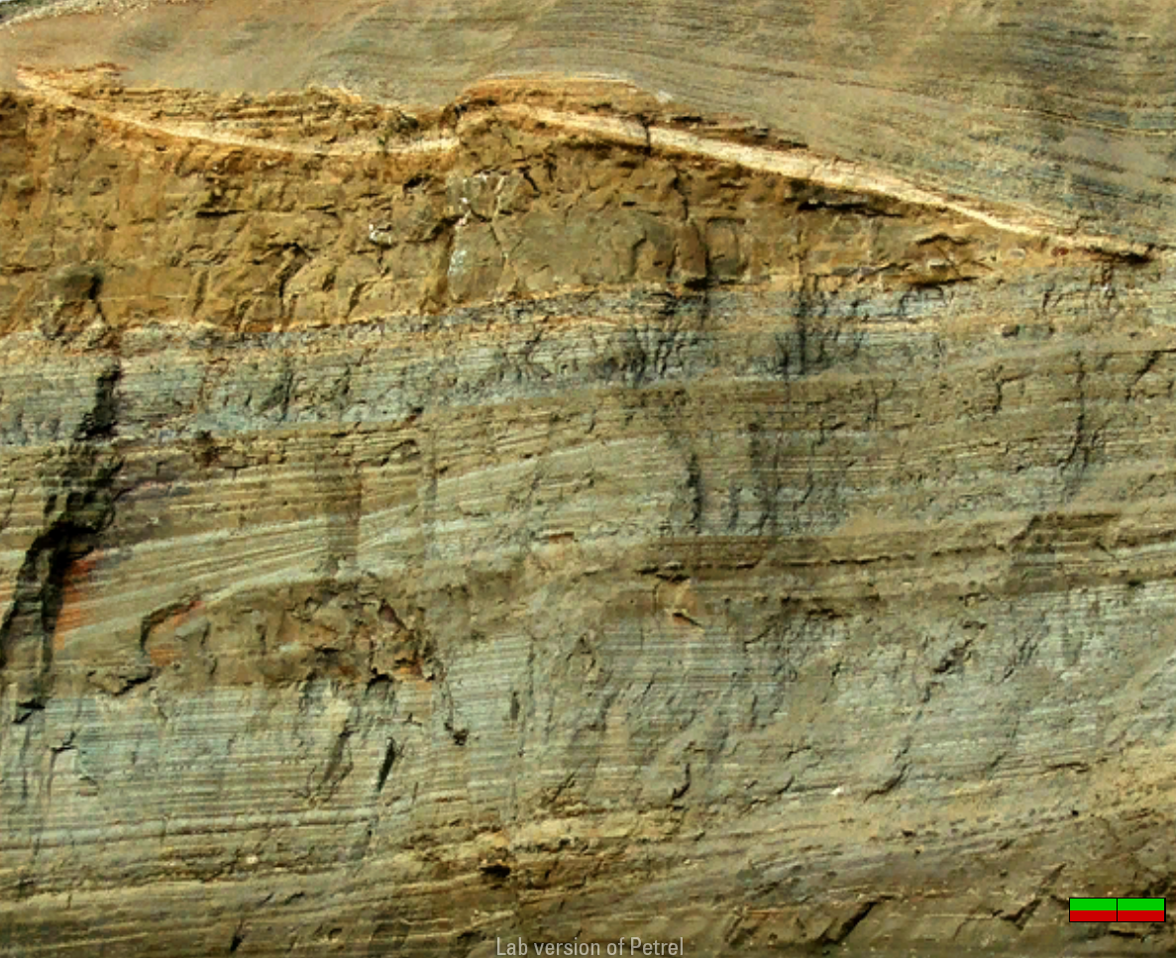
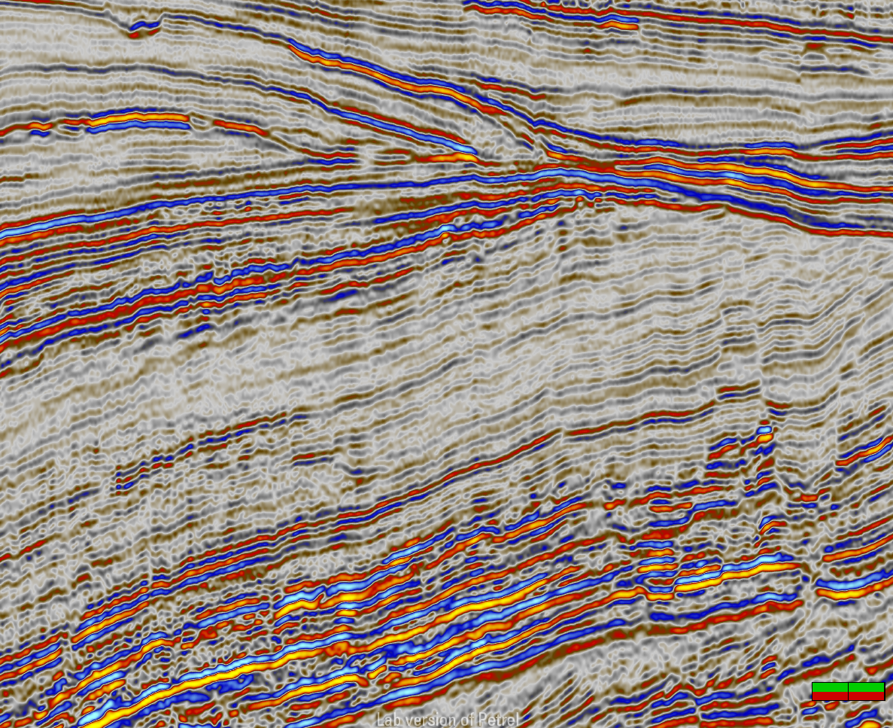
Real Rock vs Seismic Reflection
Imaging, signal processing, filtering, ray tracing
Images courtesy: Schlumberger, GTC 2015

Slide 20
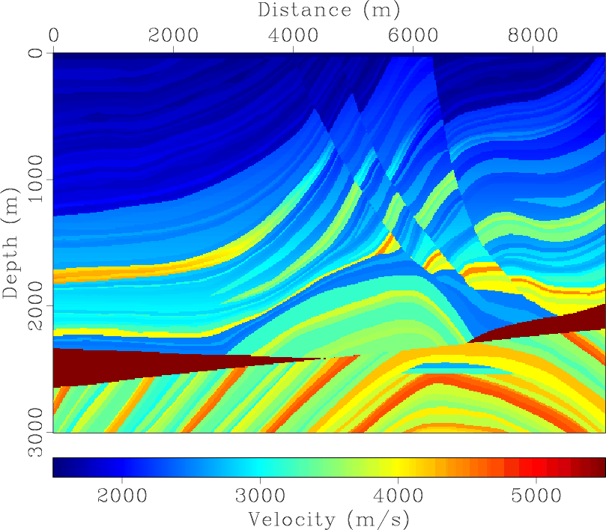
Use Known model
Verify accuracy of imaging algorithms
Industry standard dataset
Compare against known truth
Refine seismic algorithms
Improve confidence in drilling decisions
Image sources:The Marmousi velocity model

Slide 21
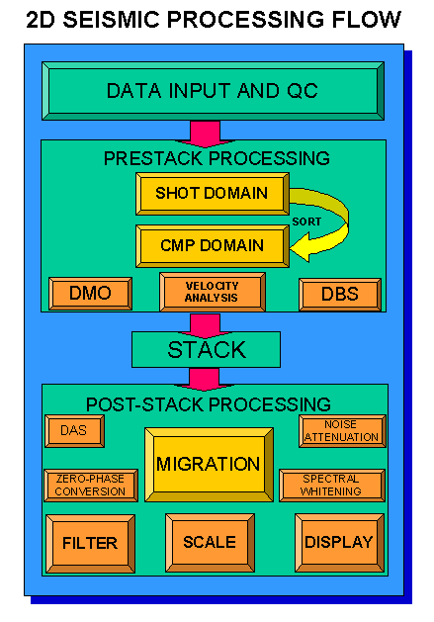
Process Seismic Data
Open Source Seismic*Unix Package
Typical Seismic Processing Flow
Iterative process
Can take several months
Migration most time consuming
Collapse diffractions
Correctly position dip events
Trusted tool: Kirchhoff Migration
Image sources: Seismic Processing The Marmousi velocity model

Slide 22
Pseudo-code for Kirchhoff Migration
sukdmig2d
main() {
...
resit();
do {
...
sum2(…,ttab, tt);
sum2(…,tsum, tsum);
mig2d(…, mig, …, mig1, …);
} while (fget(tr) && jtr<ntr);
fput(tr);
}
Update residual travel times
Loop over traces
Combine travel times (sum2)
Migrate trace (mig2d)
Low-pass filter trace
Compute amplitudes
Interpolate along lateral
Interpolate along depth
Write output

Slide 23
How you Accelerate CODE with GPUs
Assess
Parallelize
Optimize
Deploy
Notes:
Main optimization considerations are the same for GPUs and CPUs:Sufficient parallelism, vector memory access, vector execution
Both visual and command-line tools for profiling and debugging
CUDA C, CUDA Fortran, OpenACC directives

Slide 24
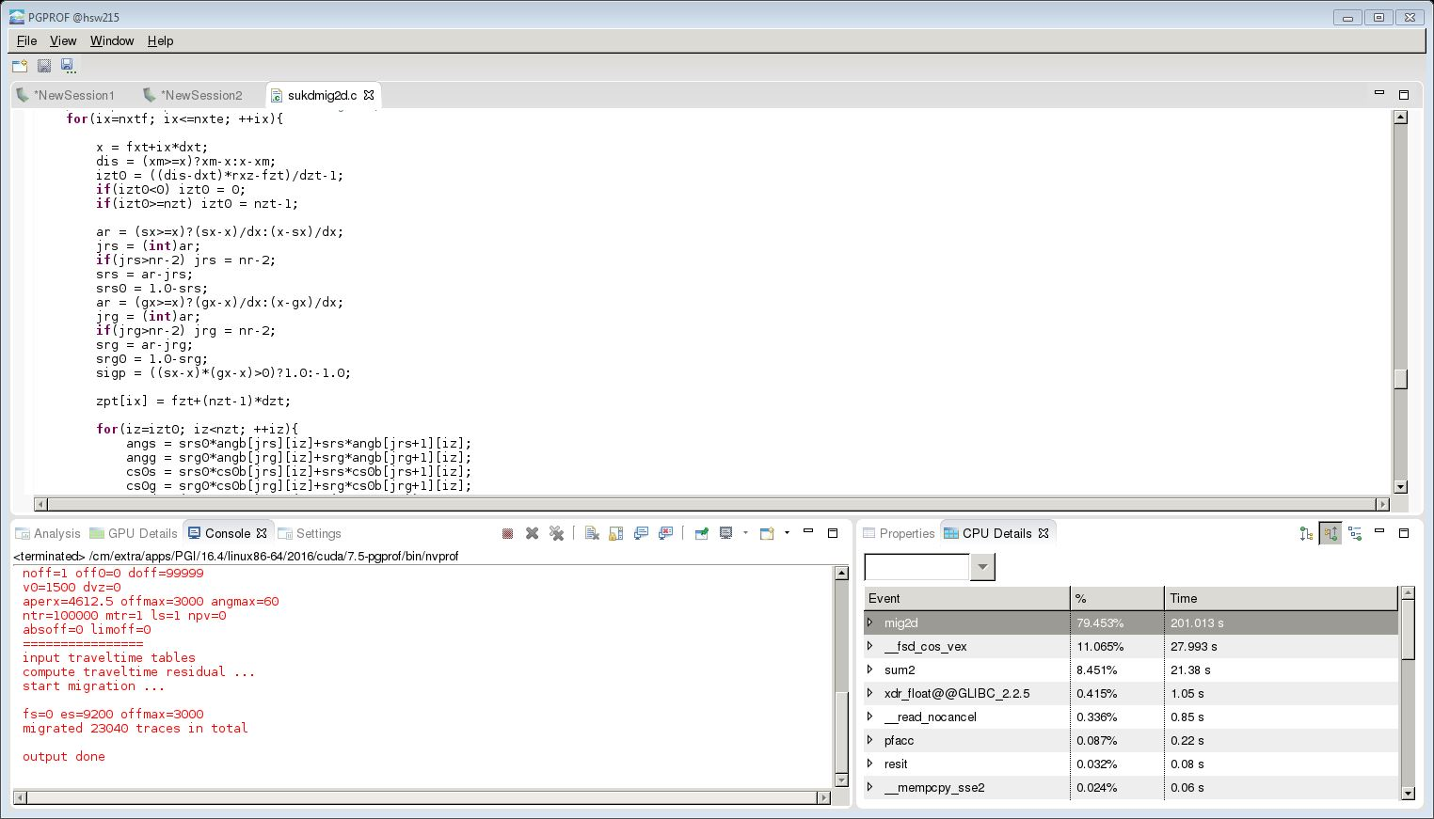
Assess baseline CPU Profile
Use pgprof sukdmig2d
Function | Percent Runtime
mig2d | 79%
sum2 | 8.5 %
resit | < 1%

Slide 25
RESULTS
SUKDMIG2D | Configuration | Model Size | Cores | Elapsed Time (s) | Speedup
CPU Only (Baseline) | 2x E5-2698 v3 2.30GHz | 2301 x 751 | 1 | 218 | 1.00

Slide 26
Acceleration with Managed Memory

Slide 27
Parallelize
mig2d:
#pragma acc parallel for
for (ix=nxtf; ix<=nxte; ++ix) {
. . .
#pragma acc loop
for (iz=izt0; iz<nzt; ++iz) {
. . .
Parallel Directives
#pragma
Parallelize for loops
Vectorize
Compiler vectorizes inner loops

Slide 28
Parallelize
void sum2(int nx, int nz,float a1,float a2,
float ** restrict t1, float ** restrict t2, float ** restrict t)
{
int ix,iz;
#pragma acc parallel for
for(ix=0; ix < nx; ++ix)
{
for(iz=0; iz < nz; ++iz)
t[ix][iz] = a1*t1[ix][iz]+a2*t2[ix][iz];
}
}
Parallel Directives
restrict on pointers!
limits aliasing
www.wikipedia.org/wiki/Restrict
#pragma
Parallelize outer for loops
Compiler parallelizes inner loop

Slide 29
Parallelize
Resit (managed):
537, Accelerator kernel generated
Generating Tesla code
538, #pragma acc loop gang /* blockIdx.x */
553, #pragma acc loop vector(128) /* threadIdx.x */
540, Loop carried dependence of t->-> prevents parallelization
Loop carried backward dependence of t->-> prevents vector
Resolve Errors!
Parallel Directives
#pragma
Parallelize for outer loop
Parallelize inner loops
Resolve loop carried depend
Add acc loop directive
Resit:
#pragma acc parallel for
for (ix=0; ix<nx; ++ix)
{
#pragma acc loop
for (is=0; is<ns; ++is)
{
. . .
#pragma acc loop
for (iz=0; iz<nz; ++iz)
t[ix][iz] -= sr0*tb[jr][iz]+sr*tb[jr+1][iz];

Slide 30

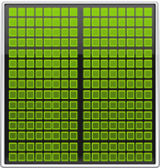
Unified memory improves productivity
Previous Developer View
Developer View With Unified Memory
System Memory
GPU Memory
Unified Memory
Notes:
On Kernel launch all data that was modified on the CPU since the last kernel is flushed to the GPU memory
Also data that is not needed on the GPU
CPU needs to refetch data afterwards even if the GPU has not modified it

Slide 31
OpenACC and Unified Memory
All heap allocations are in managed memory (Unified Memory Heap)
Pointers can be used on GPU and CPU
Enabled with compiler switch –ta=tesla:managed,…
More Info at „OpenACC and CUDA Unified Memory”, by Michael Wolfe, PGI Compiler Engineer: https://www.pgroup.com/lit/articles/insider/v6n2a4.htm

Slide 32
OpenACC and Unified Memory
Advantages
No need for any data clauses
No need to fully understand application data flow and allocation logic
Incremental profiler-driven acceleration possible
Outlook to GPU programming on Pascal

Slide 33
RESULTS
SUKDMIG2D | Configuration | Model Size | Cores | Elapsed Time (s) | Speedup
CPU Only (Baseline) | 2x E5-2698 v3 2.30GHz | 2301 x 751 | 1 | 218 | 1.00
OpenACC (Managed) | 1x K40 GPU | 2301 x 751 | 2880 | 46 | 4.70

Slide 34
RESULTS
SUKDMIG2D | Configuration | Model Size | Cores | Elapsed Time (s) | Speedup
CPU Only (Baseline) | 2x E5-2698 v3 2.30GHz | 2301 x 751 | 1 | 218 | 1.00
OpenACC (Managed) | 1x K40 GPU | 2301 x 751 | 2880 | 46 | 4.70
Now optimize using the Verbose output from compiler!

Slide 35
Optimization with Data Directives

Slide 36
Optimization
==55246== Profiling result:
Time(%) Time Calls Avg Min Max Name
42.82% 4.03645s 23040 175.19us 121.12us 196.38us mig2d_787_gpu
28.79% 2.71389s 23040 117.79us 80.800us 135.68us mig2d_726_gpu
27.35% 2.57762s 69120 37.291us 33.248us 42.240us sum2_571_gpu
1.00% 93.936ms 23040 4.0770us 3.2000us 12.992us [CUDA memcpy HtoD]
0.04% 3.4627ms 1 3.4627ms 3.4627ms 3.4627ms resit_537_gpu
0.00% 126.14us 1 126.14us 126.14us 126.14us timeb_592_gpu
==55246== API calls:
Time(%) Time Calls Avg Min Max Name
30.16% 11.5982s 230423 50.334us 118ns 3.9101ms cuMemFree
29.21% 11.2327s 230429 48.746us 10.132us 12.821ms cuMemAllocManaged
27.15% 10.4430s 253444 41.204us 1.0420us 3.4680ms cuStreamSynchronize
10.42% 4.00751s 115202 34.786us 5.4290us 99.805ms cuLaunchKernel
1.13% 433.50ms 1428513 303ns 141ns 429.42us cuPointerGetAttrib
0.81% 310.55ms 1 310.55ms 310.55ms 310.55ms cuDevicePrimary…
0.71% 273.10ms 23040 11.853us 7.3210us 409.13us cuMemcpyHtoDAsync
0.33% 125.36ms 1 125.36ms 125.36ms 125.36ms cuDevicePrimary…
0.06% 24.165ms 1 24.165ms 24.165ms 24.165ms cuMemHostAlloc…
0.02% 9.5668ms 1 9.5668ms 9.5668ms 9.5668ms cuMemFreeHost
0.00% 534.34us 1 534.34us 534.34us 534.34us cuMemAllocHost
0.00% 461.71us 1 461.71us 461.71us 461.71us cuModuleLoad..
0.00% 363.83us 2 181.91us 180.02us 183.81us cuMemAlloc
Compile
pgcc –acc \ -ta=tesla:managed
Profile !
pgprof <managed binary>

Slide 37
Optimization
main:
453, Generating update host(mig[:noff][:nxo][:nzo])
455, Generating update host(mig1[:noff][:1][:1])
459, Generating update host(mig1[:noff][:nxo][:nzo])
resit:
539, Generating copyin(ttab[:ns],tb[:][:nz])
sum2:
571, Generating copyin(t2[:nx][:nz],t1[:nx][:nz])
Generating copyout(t[:nx][:nz])
mig2d:
721, Generating copy(ampt1[nxtf:nxte-nxtf+1][:])
Generating copyin(cssum[nxtf:nxte-nxtf+1][:],tvsum[nxtf:nxte-nxtf+1][
Generating copy(tmt[nxtf:nxte-nxtf+1][:],ampti[nxtf:nxte-nxtf+1][:])
Generating copyin(pb[:][:])
Generating copy(ampt[nxtf:nxte-nxtf+1][:])
Generating copyin(cs0b[:][:],angb[:][:])
Generating copy(zpt[nxtf:nxte-nxtf+1])
782, Generating copy(mig1[nxf:nxe-nxf+1][:])
Generating copyin(ampt1[:][:], tb[:][:], tsum[:][:], ampt[:][:], ... Generating copy(mig[nxf:nxe-nxf+1][:])
Generating copyin(zpt[:])
Managed Compile
Verbose output
Guided enhancements
Targeted changes
Common Optimizations
Data Movement
Copy, copyin, copyout
Create, delete
Update
Loop Collapse

Slide 38
Optimization
main:
#pragma acc enter data create(tb,pb,cs0b,ang0)
#pragma acc enter data create(tt,tsum)
#pragma acc enter data copyin(mig, ttab)
#pragma acc enter data create(tvsum,csum )
#pragma acc enter data copyin(cs, tv)
#pragma acc enter data copyin(mig1)
After processing:
#pragma acc update host(mig)
#pragma acc update host(mig1)
Data Movement
Analyze data flow in application
Explicitly use data directives
Move data directive to main
Create only when possible
Copyin move data to GPU
Update to move data to host

Slide 39
Optimization
sum2: (managed)
571, Generating copyin(t2[:nx][:nz],t1[:nx][:nz])
Generating copyout(t[:nx][:nz])
Data Movement
Explicitly use present for
data already on GPU!
Collapse
Increase the threads nx*nz
Present
Data is already on the GPU
Prevent data movement
void sum2(int nx, int nz,float a1,float a2,
float ** restrict t1, float ** restrict t2, float ** restrict t)
{
int ix,iz;
#pragma #acc parallel for collapse(2) present(t1,t2,t)
for(ix=0; ix < nx; ++ix)
{
for(iz=0; iz < nz; ++iz)
t[ix][iz] = a1*t1[ix][iz]+a2*t2[ix][iz];
}
}

Slide 40
Optimization
mig2d:
721, Generating copy(ampt1[nxtf:nxte-nxtf+1][:])
Generating copyin(cssum[nxtf:nxte-nxtf+1][:],tvsum[...
Generating copy(tmt[nxtf:nxte-nxtf+1][:],ampti[...
Generating copyin(pb[:][:])
Generating copy(ampt[nxtf:nxte-nxtf+1][:])
Generating copyin(cs0b[:][:],angb[:][:])
Generating copy(zpt[nxtf:nxte-nxtf+1])
782, Generating copy(mig1[nxf:nxe-nxf+1][:])
Generating copyin(ampt1[:][:], tb[:][:], tsum[:][:], ... Generating copy(mig[nxf:nxe-nxf+1][:])
Data Movement
Move large data transfers to
main i.e. mig, mig1
Minimize Copyin, Copyout
Maximize Create, Present
Prevents data transfers
Use Copyin, Copyout, Copy
only when data changes!
Delete happens when
leaving scope
void mig2d(float * restrict trace, int nt, float ft,...)
{
...
#pragma acc data
copyin(trace[0:nz],trf[0:nt+2*mtmax]) \
present(mig, mig1, tb,tsum,tvsum,cssum,pb,... \
create(tmt[0:nxt][0:nzt], ampt[0:nxt][0:nzt],...
{

Slide 41
Optimization
Resit: (managed)
539, Generating copyin(ttab[:ns],tb[:][:nz])
Data Movement
Use present for data already
on GPU!
Collapse
Increase the threads nx*ns
Present
Data is already on the GPU
Prevent data movement
resit:
...
#pragma acc parallel for collapse(2) present(tb, ttab)
for (ix=0; ix<nx; ++ix)
{
for (is=0; is<ns; ++is)
{
...
#pragma acc loop
for (iz=0; iz<nz; ++iz)
t[ix][iz] -= sr0*tb[jr][iz]+sr*tb[jr+1][iz];
}

Slide 42
Optimization
void mig2d(float * restrict trace, int nt, float ft,...)
{
...
#pragma acc data
copyin(trace[0:nz],trf[0:nt+2*mtmax]) \
present(mig, mig1, tb,tsum,tvsum,cssum,pb,... \
create(tmt[0:nxt][0:nzt], ampt[0:nxt][0:nzt],...
{
...
#pragma acc parallel for
for (ix=nxtf; ix <= nxte; ++ix) {
...
#pragma acc loop
for (iz=izt0; iz < nzt; ++iz) {
...
Data Movement
mig, mig1 data large
Move to main
Copyin at start
Mark as present
Copyout for snapshots
Minimize Copyin, Copyout
Use create
Prevents copy in/out
Delete happens when leaving scope

Slide 43
Optimization
Compile
pgcc –acc -ta=tesla
Profile
pgprof <tesla binary>
mig2d and sum2 about the same.
cuAllocManged (11s) removed.
cuMemFree (11.5s) reduced to milliseconds.
==2242== Profiling result:
Time(%) Time Calls Avg Min Max Name
41.54% 3.95071s 23040 171.47us 118.88us 192.61us mig2d_787_gpu
27.91% 2.65415s 23040 115.20us 78.241us 133.09us mig2d_726_gpu
26.27% 2.49826s 69120 36.143us 32.768us 40.416us sum2_569_gpu
2.88% 274.19ms 69132 3.9660us 3.5520us 13.120us __pgi_uacc_cuda_fill_32_gpu
1.35% 128.68ms 46088 2.7920us 2.4960us 1.6815ms [CUDA memcpy HtoD]
0.04% 3.4187ms 1 3.4187ms 3.4187ms 3.4187ms resit_535_gpu
0.00% 226.15us 2 113.07us 2.4640us 223.68us [CUDA memcpy DtoH]
0.00% 123.43us 1 123.43us 123.43us 123.43us timeb_592_gpu
==2242== API calls:
Time(%) Time Calls Avg Min Max Name
85.89% 9.71880s 138246 70.300us 1.8870us 3.4228ms cuStreamSynchronize
7.69% 869.62ms 184334 4.7170us 3.4420us 452.72us cuLaunchKernel
2.94% 333.00ms 1 333.00ms 333.00ms 333.00ms cuDevicePrimaryCtxRetain
1.75% 197.59ms 46088 4.2870us 2.8370us 426.78us cuMemcpyHtoDAsync
1.15% 130.58ms 1 130.58ms 130.58ms 130.58ms cuDevicePrimaryCtxRelease
0.25% 28.337ms 1 28.337ms 28.337ms 28.337ms cuMemHostAlloc
0.20% 23.059ms 46084 500ns 260ns 11.292us cuPointerGetAttributes
0.09% 10.027ms 1 10.027ms 10.027ms 10.027ms cuMemFreeHost
0.03% 2.9512ms 31 95.199us 2.9220us 300.63us cuMemAlloc
0.01% 806.38us 2 403.19us 188.55us 617.83us cuModuleLoadData
No longer compiling with :managed

Slide 44
RESULTS
SUKDMIG2D | Configuration | Model Size | Cores | Elapsed Time (s) | Speedup
CPU Only (Baseline) | 2x E5-2698 v3 2.30GHz | 2301 x 751 | 1 | 218 | 1.00
OpenACC (GPU Managed) | 1x K40 GPU | 2301 x 751 | 2880 | 46 | 4.70
OpenACC (GPU Native) | 1x K40 GPU | 2301 x 751 | 2880 | 12 | 15.60

Slide 45
Multicore Comparison

Slide 46
Optimization
How about Multi-Core / OMP / pthread?
======== CPU profiling result (top down):
72.91% main
| 69.84% mig2d
| | 43.19% __pgi_acc_barrier
| | | 43.19% _mp_barrier_tw
| | | 0.02% _mp_pcpu_get_team_lcpu
| | | 0.02% _mp_pcpu_struct
| | | 0.01% __tls_get_addr
| | 0.12% malloc@@GLIBC_2.2.5
| 2.88% sum2
| | 2.79% __pgi_acc_barrier
| | | 2.79% _mp_barrier_tw
| | 0.00% .ACCENTER
| | 0.00% _mp_barrierr
| 0.10% __fsd_cos_vex
| 0.05% __pgi_acc_pexit
| | 0.05% _mp_cpexit
| | 0.05% _mp_barrierw
22.18% _mp_slave
| 22.18% _mp_cslave
| 22.18% _mp_barrier_tw
| 0.02% _mp_pcpu_yield
| 0.02% sched_yield
4.77% __fsd_cos_vex
0.09% filt
-- more --
Done!
Re-Compile
pgcc –acc -ta=multicore
Profile !
pgprof
--cpu-profiling on \
--cpu-profiling-scope function \
--cpu-profiling-mode top-down \
<app> <args>

Slide 47
RESULTS
SUKDMIG2D | Configuration | Model Size | Cores | Elapsed Time (s) | Speedup
CPU Only (Baseline) | 2x E5-2698 v3 2.30GHz | 2301 x 751 | 1 | 218 | 1.00
OpenACC CPU (Multicore) | 2x E5-2698 v3 2.30GHz | 2301 x 751 | 16 | 29 | 7.50
OpenACC GPU (Managed) | 1x K40 GPU | 2301 x 751 | 2880 | 46 | 4.70
OpenACC GPU (Native) | 1x K40 GPU | 2301 x 751 | 2880 | 12 | 15.60

Slide 48
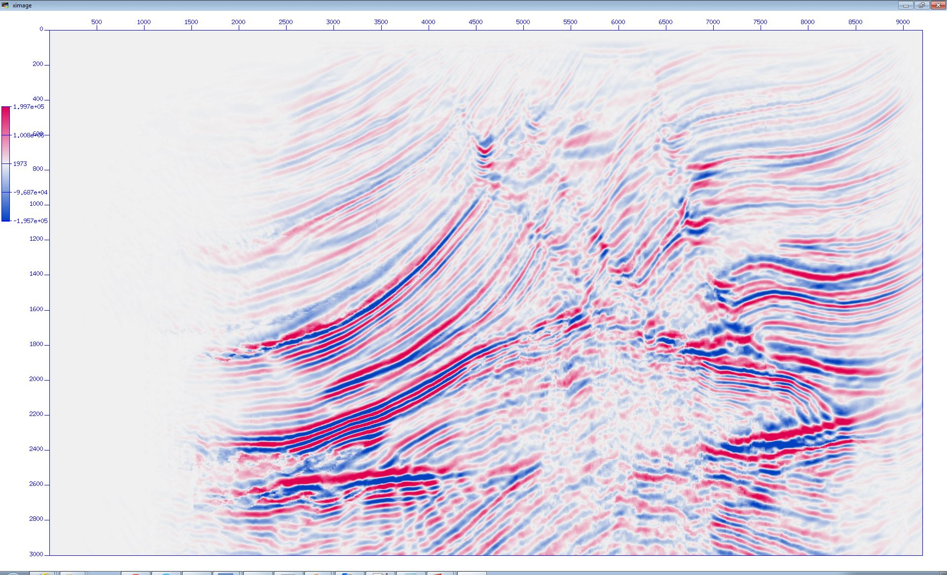
deploy
How do the results compare?
CPU Only (Baseline) | OpenACC Multicore | OpenACC (GPU)

Slide 49
Homework

Slide 50
Qwiklabs: Getting access
1. Go to https://developer.nvidia.com/qwiklabs-signup
2. Register with OpenACC promo code to get free access
3. Receive a confirmation email with access instructions
Questions?
Email to openacc@nvidia.com

Slide 51
Access to Homework
Qwiklab:
Profile-driven approach to accelerate Seismic application with OpenACC
Link: http://bit.ly/oaccnvlab6
Requirements: OpenACC Compiler and CUDA-aware MPI
Link to the source code on github thorough the qwiklab if you want to try it on your machine

Slide 52
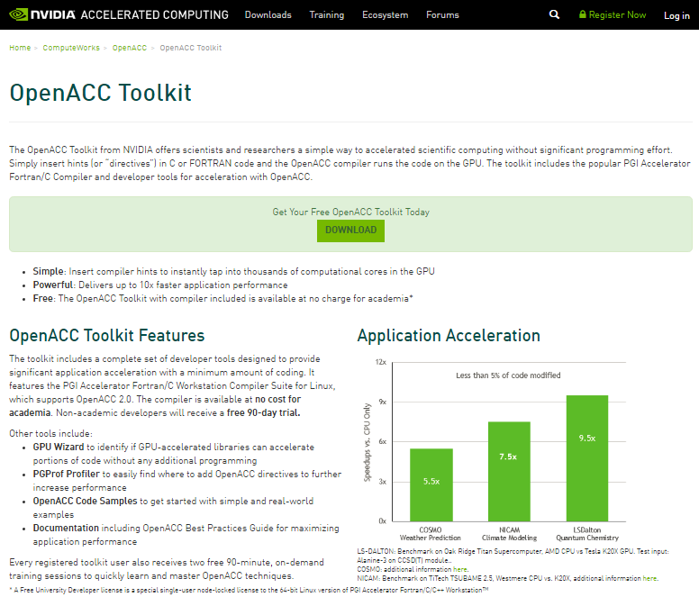
Install the OpenACC Toolkit (Optional)
Go to developer.nvidia.com/openacc-toolkit
Register for the OpenACC Toolkit
Install on your personal machine (Linux Only)
Free workstation license for academia/90 day free trial for the rest

Slide 53
On Your Own …
Local Seismic Unix Setup

Slide 54
Setup Seismic Unix
Center for Wave Phenomena
Download Seismic Unix
ftp://ftp.cwp.mines.edu/pub/cwpcodes/cwp_su_all_43R8.tgz
Unpack to ~/cwp
Set environment variables
CWPROOT=~/cwp
PATH=~/cwp/bin:$PATH
Edit Makefile.config, build
Use PGI compilers (CC=pgcc, FC=pgfortran)
OPTC=-g, FFLAGS=$(FOPTS)

Slide 55

SETUP SEISMIC UNIX
Marmousi Datasets
Download Marmousi data, velocity, and density files
http://www.trip.caam.rice.edu/downloads/ieee.tar.gz
Convert SEGY format to SU format
#!/bin/bash
segyread tape=data.segy conv=0 endian=0 > data.su segyread tape=velocity.segy conv=0 endian=0 > velocity.su
suflip flip=0 < velocity.su > velocity1.su sustrip < velocity1.su > velocity.h@ ftn=0
suwind < data.su > data1.su tmax=2.9

Slide 56
Setup Seismic Unix
Smooth, build ray trace model, migrate
#!/bin/bash
nz = 751 nx = 2301 dz = 4 dx = 4 nt = 750 ntr= 96 dt = 4000 ifile = data1.su ofile = datamig.su tfile = tfile vfile = velocity.h@
#smoothing time smooth2 < $vfile n1=$nz n2=$nx r1=20 r2=20 >smoothvel
#raytrace time rayt2d < smoothvel dt=0.004 nt=751 dz=$dz nz=$nz dx=$dx nx=$nx fxo=0 dxo=25 nxo=369 fxs=0 dxs=100 nxs=93 >$tfile #migrate (Example) sukdmig2d infile=$ifile datain=$ifile outfile=$ofile dataout=$ofile ttfile=$tfile fzt=0 dzt=4 nzt=751 fxt=0 dxt=25 nxt=369 fs=0 ns=93 ds=100 nzo=751 dzo=4 dxm=25 mtr=1

Slide 57
Where to find help
OpenACC Course Recordings - https://developer.nvidia.com/openacc-courses
PGI Website - http://www.pgroup.com/resources
OpenACC on StackOverflow - http://stackoverflow.com/questions/tagged/openacc
OpenACC Toolkit - http://developer.nvidia.com/openacc-toolkit
Parallel Forall Blog - http://devblogs.nvidia.com/parallelforall/
GPU Technology Conference - http://www.gputechconf.com/
OpenACC Website - http://openacc.org/
Questions? Email openacc@nvidia.com

Slide 58
May 19: Advanced Profiling of OpenACC Code
May 26: Office Hours <- Visual Profiler
June 2: Advanced multi-GPU Programming with MPI and OpenACC
June 9: Office Hours
Course Syllabus
Recordings:
https://developer.nvidia.com/openacc-advanced-course
Questions? Email openacc@nvidia.com

